Slide 1
Lie numbers
Data 2019

Slide 2
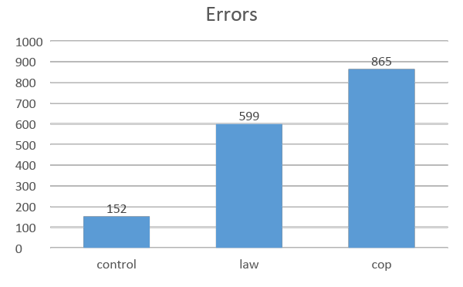
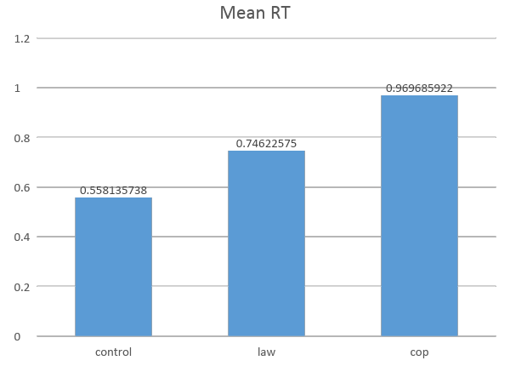
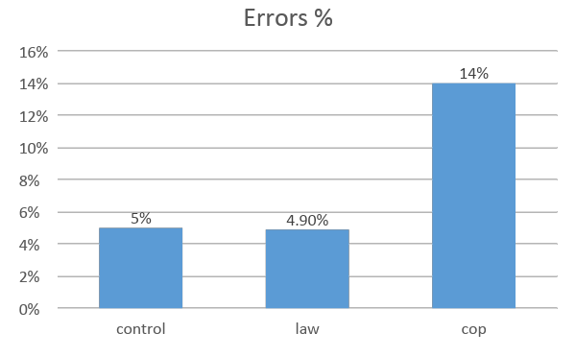
Overview conditions
N = 38
Trials:
Control = 80
Lawyer = 240
Cop = 160

Slide 3
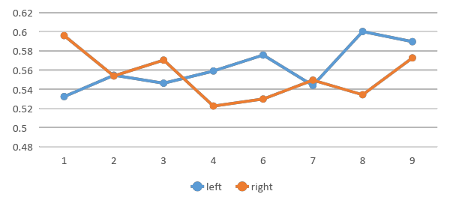
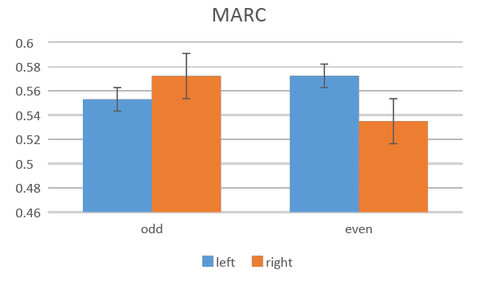
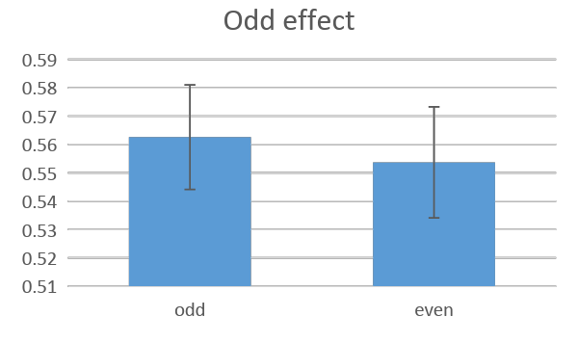
ONLY LAWYER – Control condition (RT)
Hand*parity F(1, 26)= 3.413, p= .076
Parity F(1, 26)= 1.989, p= .17

Slide 4
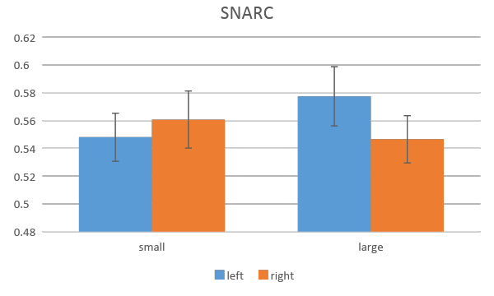
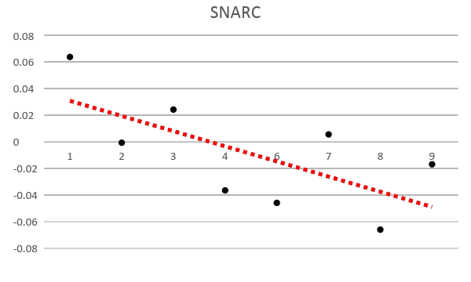
ONLY LAWYER – Control condition (RT)
Hand*magnitude F(1, 26)= 13.47, p= .001
Regression t(26) = -3.995, p = .000

Slide 5
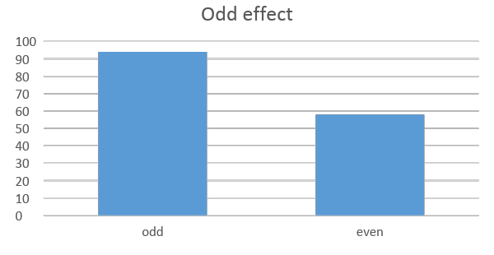
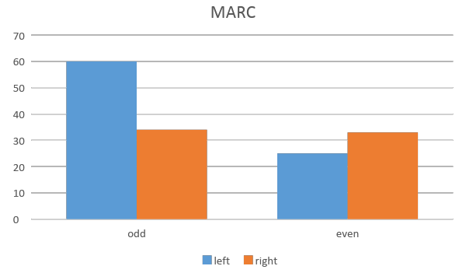
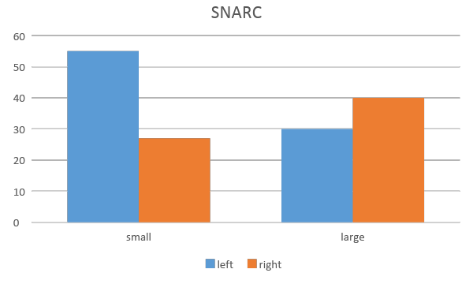
ONLY LAWYER – Control condition (ERRORS)
Parity F(1, 37) = 4.26, p = .001
Hand * parity F(1, 37) = 4.66, p = .037
Hand * mag F(1, 37) = 7.73, p = .009

Slide 6
ONLY LAWYER – Control condition
From RTs we have a clear SNARC effect, as expected, and a marginally significant MARC effect. But no odd effect (general advantage for even vs. odd numbers) nor any left/right advantage.
Results from error analysis are quite puzzling. Indeed, an odd effect appears (more errors for odd vs. even) but data suggests a reversed SNARC (more errors for left/small and right/large) and MARC effect (more errors for left/odd and right/even).
This looks to me like a trade off effect (e.g., left resp are faster to small so they are also more prone to errors than left/right). A reflection here is needed.

Slide 7
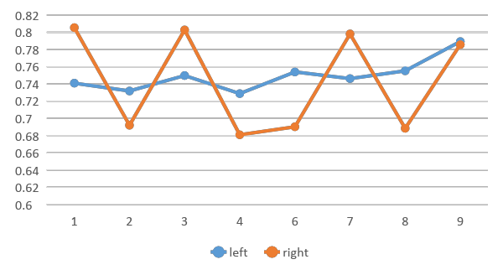
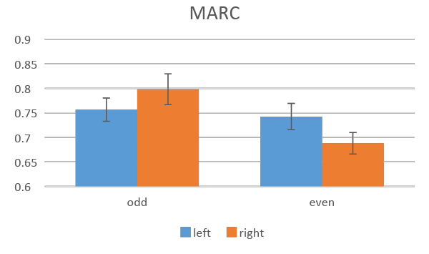
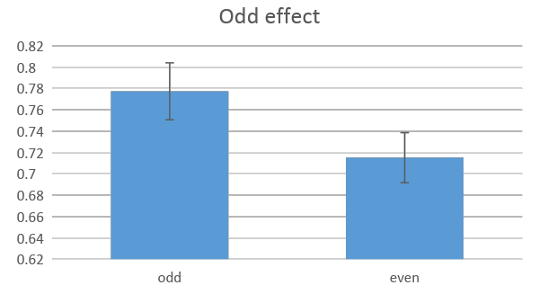
LAWYER – Lie condition (RT)
Hand * parity F(1, 26) = 3.57, p = .070
Parity F(1, 26) = 41.69, p = .000

Slide 8
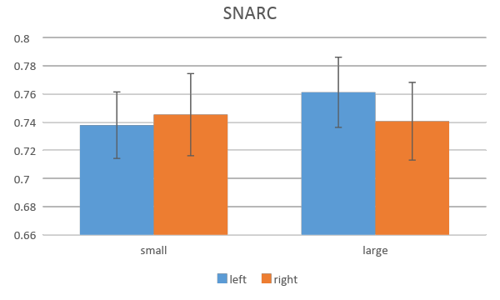
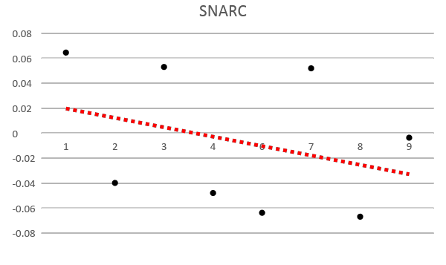
LAWYER – Lie condition (RT)
Hand * mag F(1, 26) = 6.13, p = .020
Reg t(26) = -3.07, p = .005

Slide 9
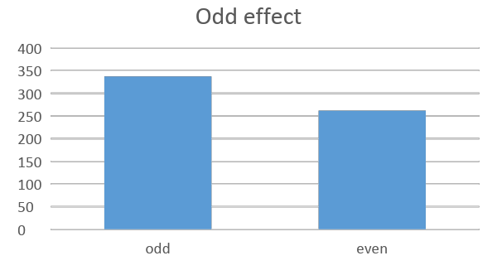
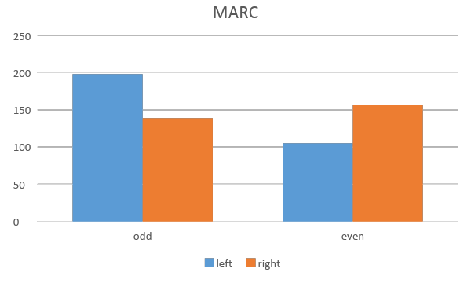
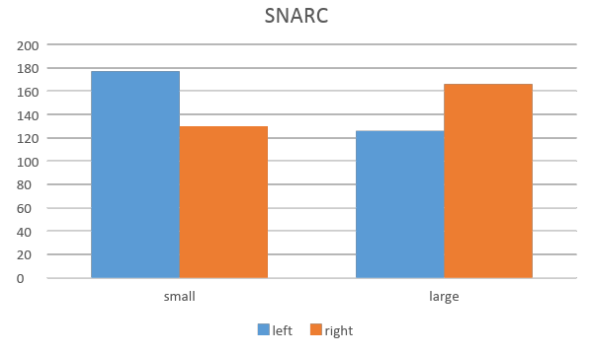
LAWYER – Lie condition (ERRORS)
Parity F(1, 37) = 6.56, p= .015
Hand * parity F(1, 37) = 4.13, p = .049
Hand * mag F(1, 37) = 13.86, p = .001

Slide 10
LAWYER – Lie condition
From RTs we have again a clear SNARC effect, as expected, and a marginally significant MARC effect. Here we have a very clear odd effect (general advantage for even vs. odd numbers) but no any left/right advantage.
Again results from error analysis are quite puzzling. Indeed, an odd effect appears (more errors for odd vs. even) in line with RTs but data suggests a reversed SNARC (more errors for left/small and right/large) and MARC effect (more errors for left/odd and right/even).
This looks to me like a trade off effect (e.g., left resp are faster to small so they are also more prone to errors than left/right). A reflection here is needed.

Slide 11
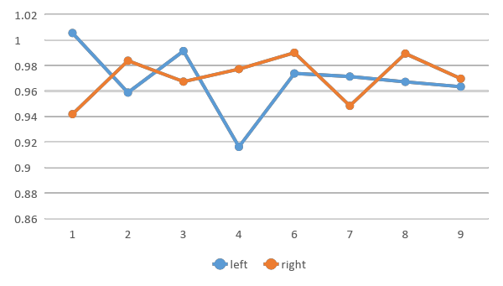
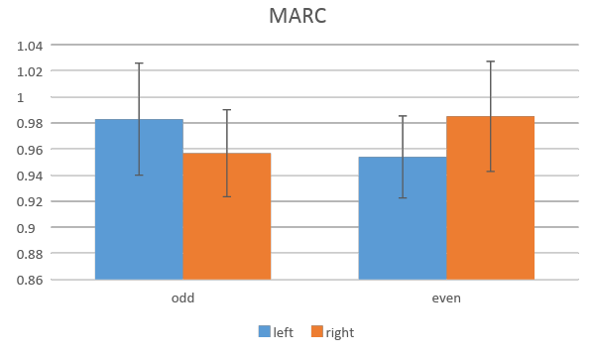
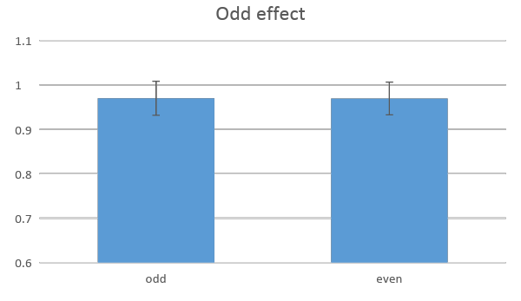
COP – Lie condition (RT)
Hand * number F(1, 26) = .76, p = .39
Parity F(1, 26) = 0.002, p = .97

Slide 12
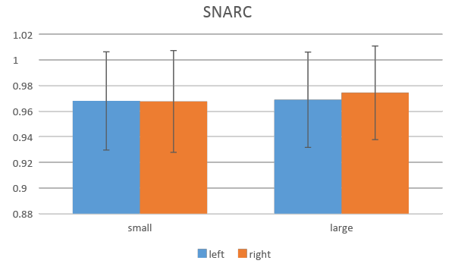
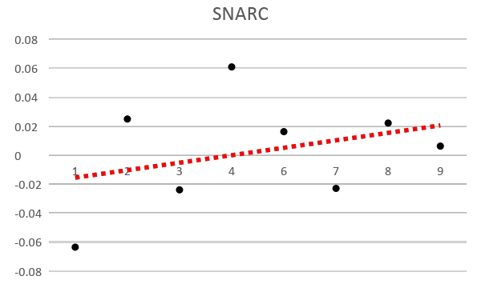
COP – Lie condition (RT)
Hand * magnitude F(1, 26) = .100, p = .75
t(26) = 0.98, p = .338

Slide 13
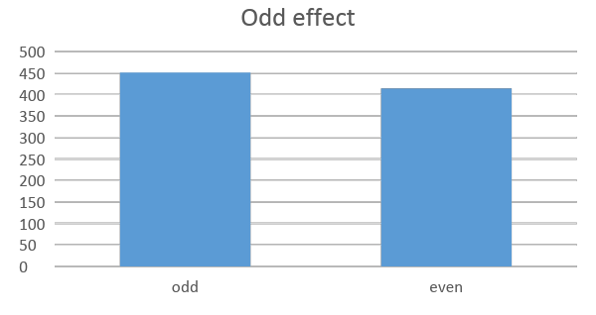
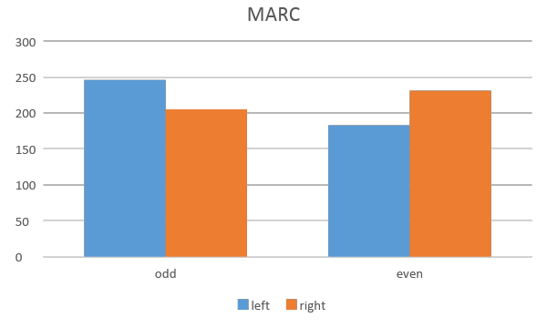
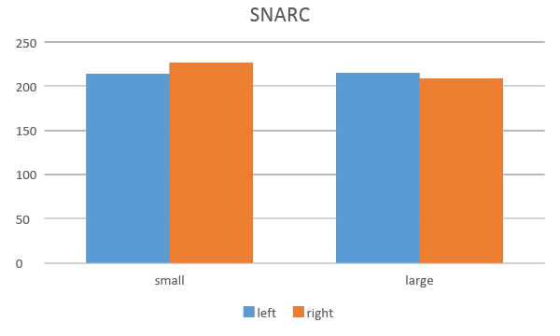
COP – Lie condition (ERRORS)
Parity F(1, 37) = 1.41, p= .243
Hand * parity F(1, 37) = 5.27, p = .028*
Hand * mag F(1, 37) = 0.35, p = .56

Slide 14
COP – Lie condition
Nothing significant here from RTs. Data looks like a reversed SNARC and MARC effect but they are far from significance. No odd effect and no any left/right advantage.
Results from error analysis show a reversed MARC effect (more errors for left/odd and right/even) in line other conditions. Errors are in line with a SNARC but far from sig.
Is it still possible to have a trade off effect here again, this time compatible with a rev SNARC effect? Not sure if there are some more sophisticated analysis that we can use to combine error and RT analysis.

